Slide 1
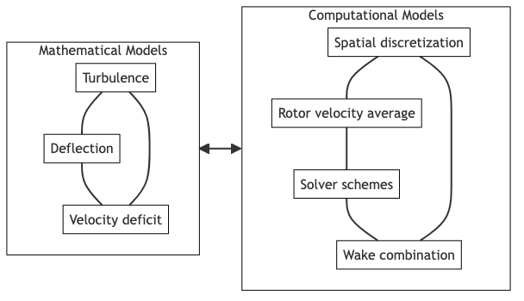
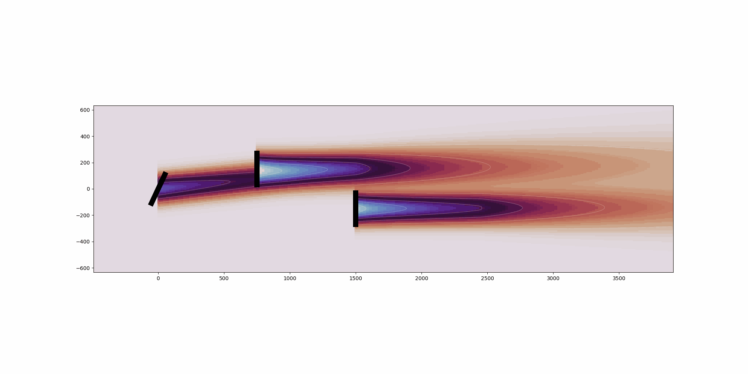
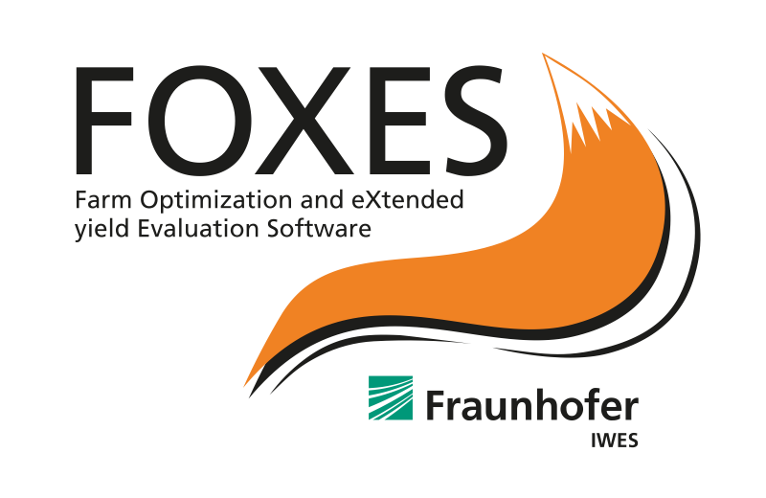


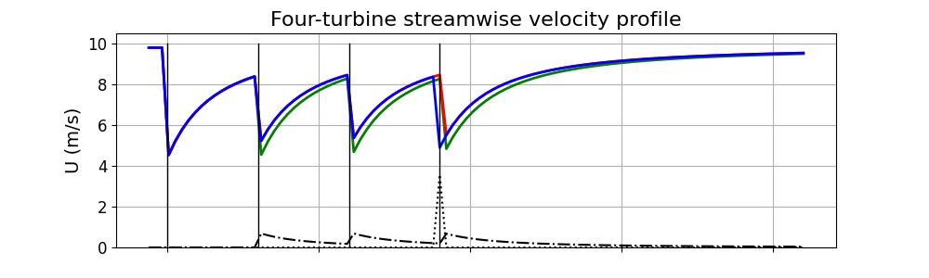
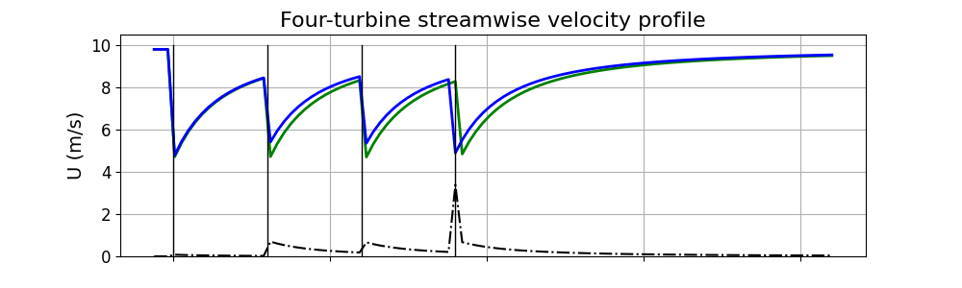
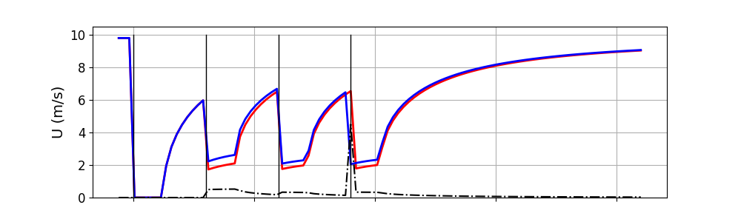
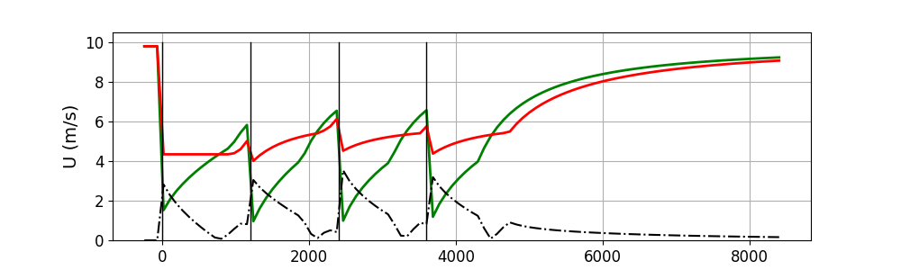
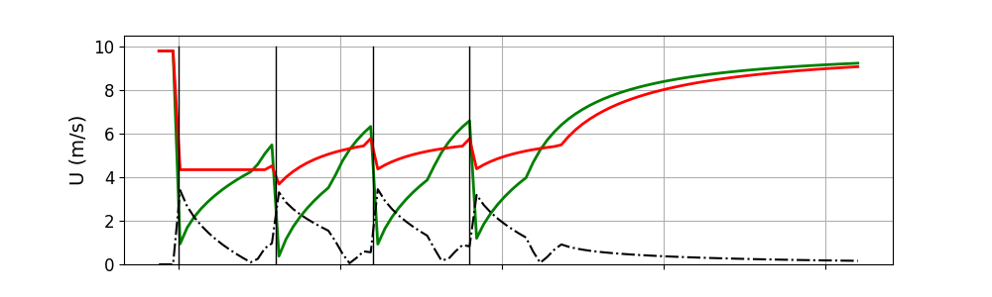
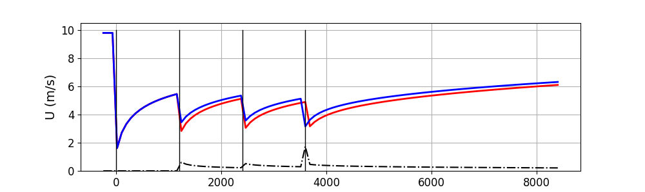





Comparison of steady-state analytical wake models implemented in wind farm analysis software
Rafael Mudafort¹, Julian Quick², Jonas Schulte³
¹National Renewable Energy Laboratory, ²Technical University of Denmark, ³Fraunhofer Institute for Wind Energy Systems
Are software implementations of common mathematical models consistent?
Wind farm flow control presents an opportunity to improve the cost of energy and energy yield of wind farms in specific environments. A class of software tools that model the effects of wake losses and opportunities for wake loss mitigation via wind farm flow control has emerged in the past decade. Many of these tools share key characteristics:
Written in the Python programming language
Implement multiple steady-state, analytical wake models
Target workstation use
Integrate with optimization software ecosystems
Are the mathematical models implemented consistently within computational models in this class of software?
Software projects, mathematical models and comparison framework
Wake Velocity Model | FLORIS | FOXES | PyWake
Jensen 1983 | • | • | •
Larsen 2009 |  |  | •
Bastankhah / Porté-Agel 2014 |  | • | •
Bastankhah / Porté-Agel 2016 | • | •
Niayifar / Porté-Agel 2016 |  |  | •
IEA Task 37 Bastankhah 2018 |  |  | •
Carbajo Fuertes / Markfort / Porté-Agel 2018 |  |  | •
Blondel / Cathelain 2020 |  |  | •
Zong / Porté-Agel 2020 |  |  | •
Cumulative Curl 2022 | •
TurbOPark (Nygaard) 2022 | •* | • | •
Empirical Gauss 2023 | •
FLORIS has been in development at NREL in various forms since 2014, and the current iteration began in 2017. FLORIS is designed to support the development and implementation of new wake models, as well as wind farm energy yield calculation and wind farm layout and controls design. The software architecture is designed with explicit interfaces where new models can be integrated into the existing framework.
FLORIS
FOXES has been in development since 2022 at Fraunhofer IWES. It is designed as a modular tool for modelling aspects of wind farm calculations allowing users to combine existing models and easily add new models. FOXES directly integrates with optimization libraries that allow for any variable to be optimized.
PyWake has been in development at DTU since 2018. It is used to study the interaction between turbines within a wind farm and its influence on the farm’s flow field and power production. It has a modular architecture providing predefined modelling blocks for calculating annual energy production.
wcomp is a Python package from NREL that provides an interface to data structures and plotting functions that enable the comparison of wake model implementations across different software tools. At its core, wcomp provides an interface to windIO, data structures to contain the results of a wind farm wake model simulation and plotting functions to inspect these data structures.
Wake Deflection Model | FLORIS | FOXES | PyWake
Jímenez 2010 | • |  | •
Bastankhah / Porté-Agel 2016 | • | •
Larsen et al 2020 |  |  | •
Empirical Gauss 2023 | •
4-turbine case comparison
Wake velocity models
Wake deflection models
FLORIS
FOXES
PyWake
Turbine locations
Jensen 1983
Jímenez 2010
Bastankhah / Porté-Agel 2014
Bastankhah / Porté-Agel 2016
Are common models consistent? Nearly yes!
Some differences are found across common mathematical models. However, this study is limited by the configurations available in windIO. Additional modeling considerations are:
Method for computing the wind speed at the rotor
Grid point location and spacing
Wind shear modeling
Wake combination methods
Turbulence intensity modeling
Handling for partially waked wind turbines
Bastankhah / Porté-Agel 2016
TurbOPark (Nygaard) 2022
Get involved to create the ensemble of wind farm wake model software!
This study establishes a method and tool for creating an ensemble of results of mathematical wake models commonly implemented in computational frameworks. A key finding is that the implementations are nearly consistent, and differences may be explained through further investigation and alignment of computational modeling decisions. The authors will extend and expand the comparison of this class of computational tools by including additional computational model components and establishing characteristic test cases.
See the full comparison
Add your results to the ensemble
This work was authored by the National Renewable Energy Laboratory, operated by Alliance for Sustainable Energy, LLC, for the U.S. Department of Energy (DOE) under Contract No. DE-AC36-08GO28308. Funding provided by the U.S. Department of Energy Office of Energy Efficiency and Wind Energy Technologies Office. The views expressed in the article do not necessarily represent the views of the DOE or the U.S. Government. The U.S. Government retains and the publisher, by accepting the article for publication, acknowledges that the U.S. Government retains a nonexclusive, paid-up, irrevocable, worldwide license to publish or reproduce the published form of this work, or allow others to do so, for U.S. Government purposes.

